Slide 1
Conway’s Game of Life
Wila Braga

Slide 3
Description
Zero-player game
Deterministic based on starting state
Cellular automaton
Grid of cells
Finite states
Neighborhood of cells
Update Rules

Slide 4
Rules Background
John Conway chose the automaton update rules to achieve the following:
No explosive growth
Small initial patterns with chaotic, unpredictable outcomes
Potential for von Neumann universal constructors (i.e. self-replication)
Rules should be as simple as possible while maintaining 1-3

Slide 5
Rules
A cell lives (turns black) or dies (turns white) depending on its 8 adjacent neighbors:
If a live cell has fewer than two live neighbors (underpopulation), the cell dies
If a live cell has two or three live neighbors, the cell continues to live
If a live cell has more than three live neighbors (overpopulation), the cell dies
If a dead cell has exactly three live neighbors (reproduction), it becomes live

Slide 6
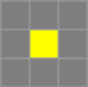
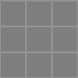
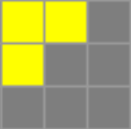
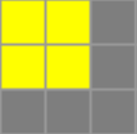
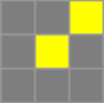
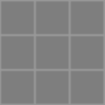
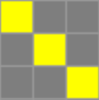
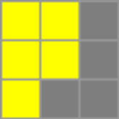
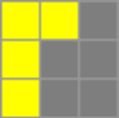

Slide 7
Pseudocode
grid = boolean[][];
temp = copy(grid); //rules applied simultaneously
for each generation:
for i, j in grid:
live_neighbors = 0;
for di, dj in [-1, 1] except di == dj == 0:
if grid[i+di][j+dj]:
live_neighbors += 1;
if live_neighbors < 2 or live_neighbors > 3:
temp[i][j] = false; //dead
if live_neighbors == 3:
temp[i][j] = true; //alive
grid = temp;

Slide 8
Encoding with Shape Machine
Game Rules
geometrize
Shape Rules
update
Visualization

Slide 9
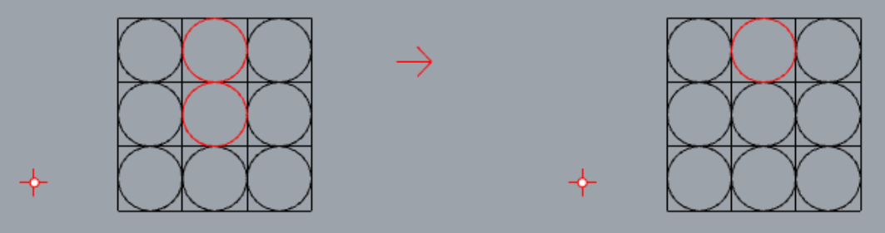
Rule Format

Slide 10
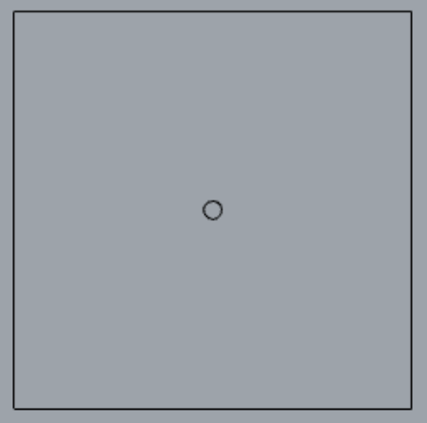
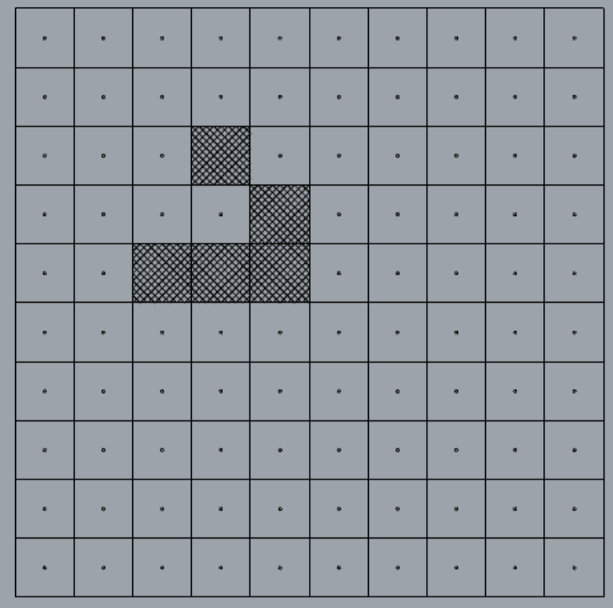
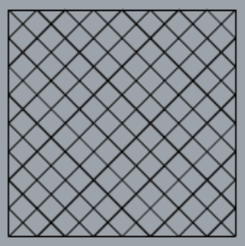
Visualization
Dead
Live

Slide 11
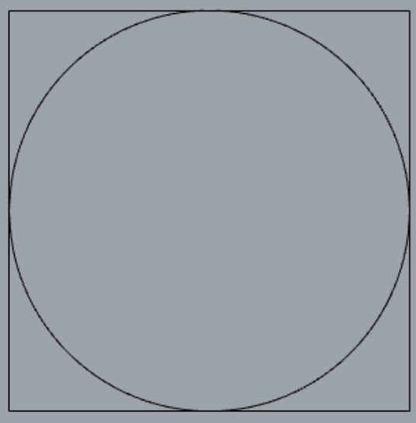
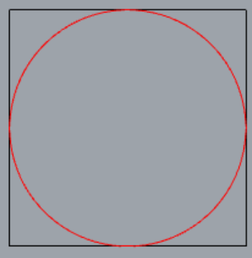
Optimization

Slide 12
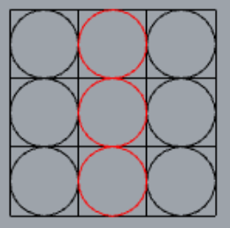
Simultaneous Update - 1
What can happen after 1 generation?
Assuming the machine scans from top left to bottom right and grid wrapped by dead cells

Slide 13
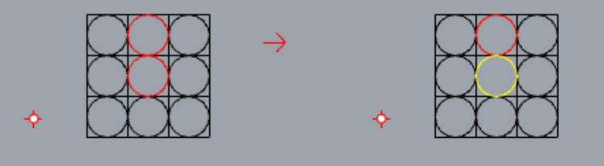
Simultaneous Update - 2
What if we add intermediate circle values?
Yellow = To be removed

Slide 14
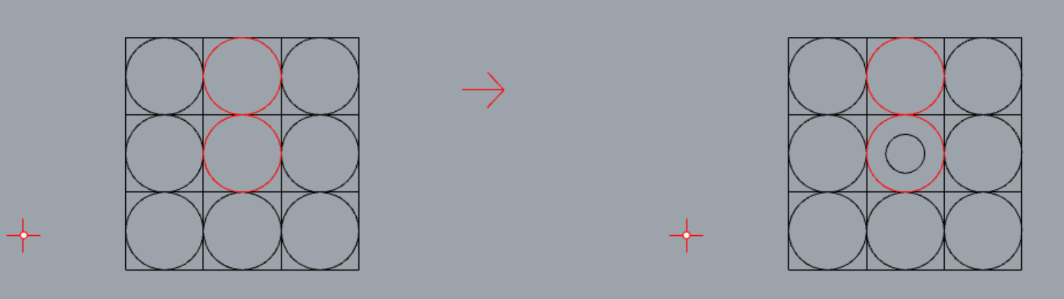
Simultaneous Update - 3
Cells must not change state within a generation
Cells must be marked to be changed at the end of a generation
Marked cells must still be seen as alive or dead when processing neighbors

Slide 15
0 Live Neighbors
C(8, 0) = 1

Slide 16
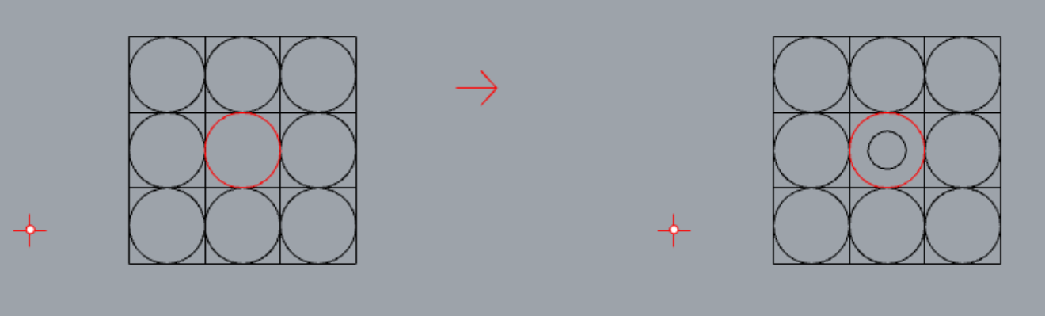
aka
4 axes of symmetry = 1 graph

Slide 17
1 Live Neighbor
C(8, 1) = 8

Slide 18
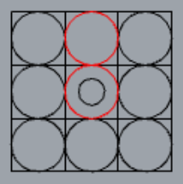
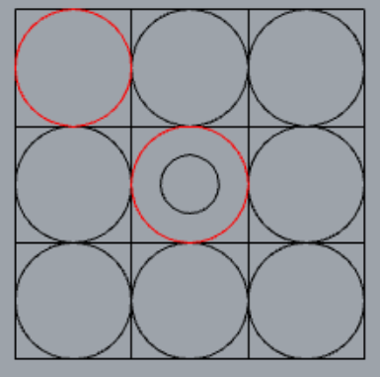
1 axis = 4 graphs
1 axis = 4 graphs

Slide 19
3 Live Neighbors
C(8, 3) = 56

Slide 20
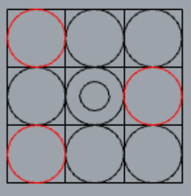
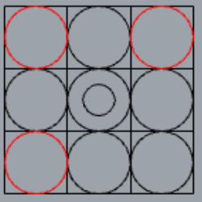
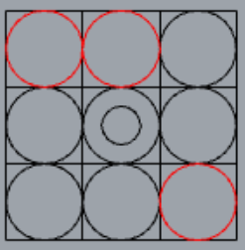
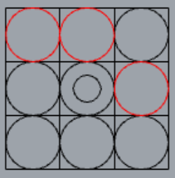
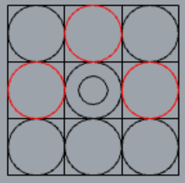
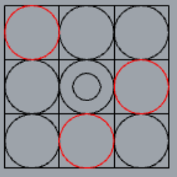
4
4
8
8
4
4
32

Slide 21
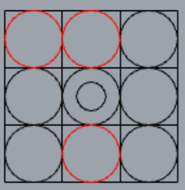
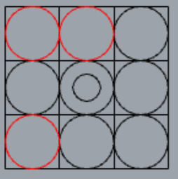
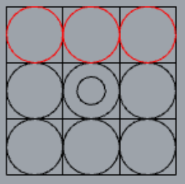
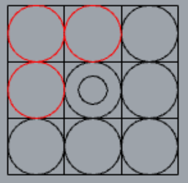
8
8
4
4
56

Slide 22
4 Live Neighbors
C(8, 4) = 70

Slide 23
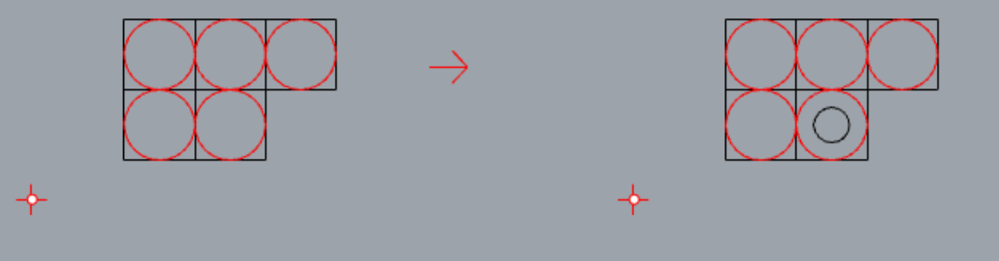
Format of 4+ Neighbor Rules

Slide 24
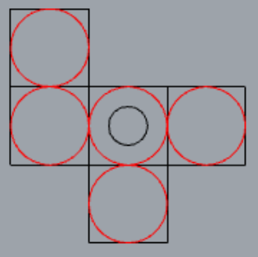
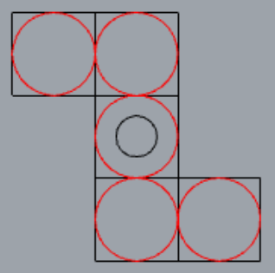
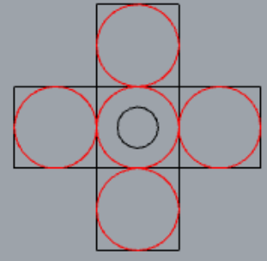
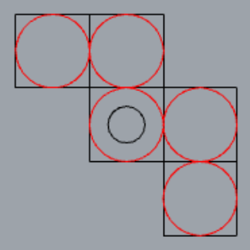
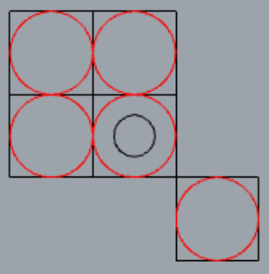
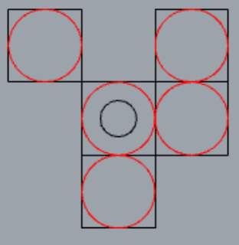
8
4
1
4
4
8
29

Slide 25
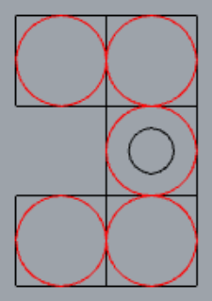
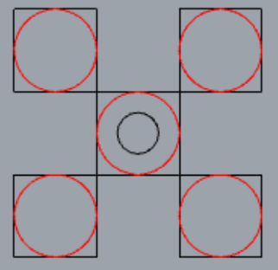
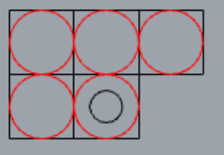
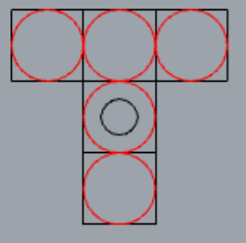
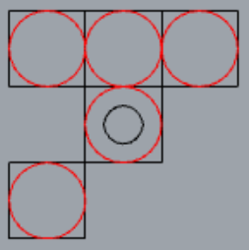
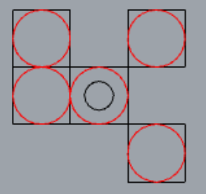
16*
4
1
8
4
8
70

Slide 26
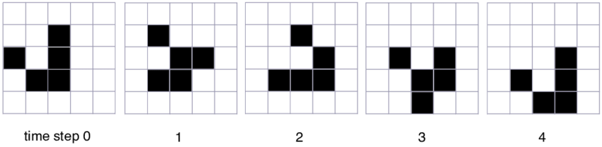
Glider

Slide 27
Glider - Shape Machine

